Slide 1

Open a Restaurant in Toronto
Capstone Project - The Battle of Neighborhoods
Chenxin Xu

Slide 2

Introduction
Overall Background--Toronto:
Capital of the province of Ontario, is a major Canadian city along Lake Ontario’s northwestern shore
GDP: 385,934 dollars
Population: 27,31,571

Slide 3

Introduction
Goal:
Open a restaurant in Toronto and make profits
3 Criteria:
Population density in neighborhoods
Ethic in Toronto
Cluster of people
Conclusion:
Type of the restaurant
Location
Operation strategics

Slide 4

Data
Neighborhood Profiles from Toronto Government Website
Population in each area
Ethic for the whole city
Community Housing dataset
The number of markets in each area
RGI
Rent-Geared-to-Income (RGI) which is a housing subsidy or benefit offered by the City of Toronto to make rent affordable
Toronto Geometry file
In GEOJSON

Slide 5
Methodology

Slide 6
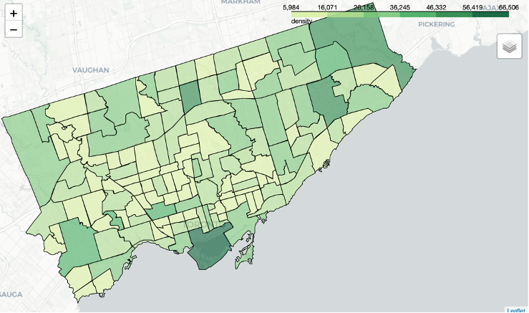
Population Density
Demography including the population in each neighborhood and the increasing rate
Split neighborhood profiles data to acquire population
Apply choropleth map with GEOJSON file
Deeper, higher density

Slide 7
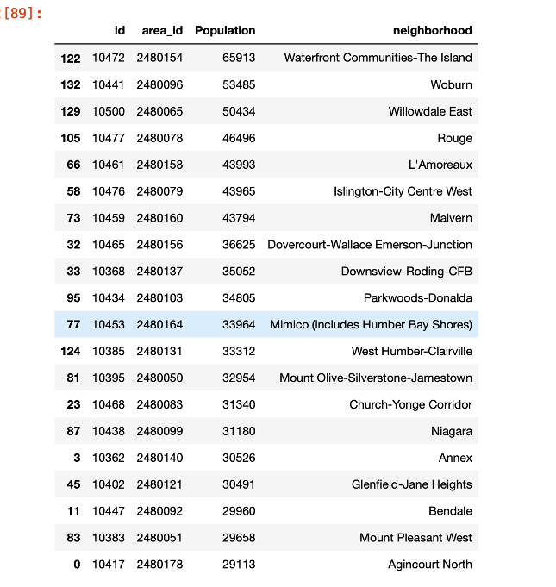
Neighborhoods with Top 20 Population
Three highest density neighborhoods:
Waterfront Communities-The Island
Woburn
Willowdale East

Slide 8
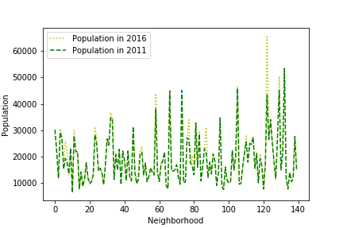
Population Trends
Decrease the impact of outdated data
Compare the population in 2011 and 2016
Waterfront Communities-The Island increases its population dramatically followed by Niagara and Henry Farm

Slide 9
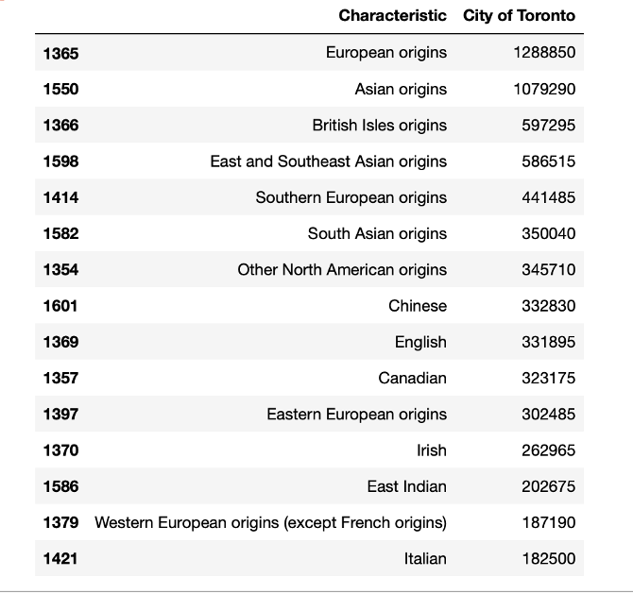
Ethic Analysis
Split the original dataset into a new data set with data:
The ethic
Total number of people with that ethic in Toronto
First 7 rows represent the continents
Starting with row 8 represents each country
Most people are European origins and Chinese ethic

Slide 10

Finance Analysis

Slide 11
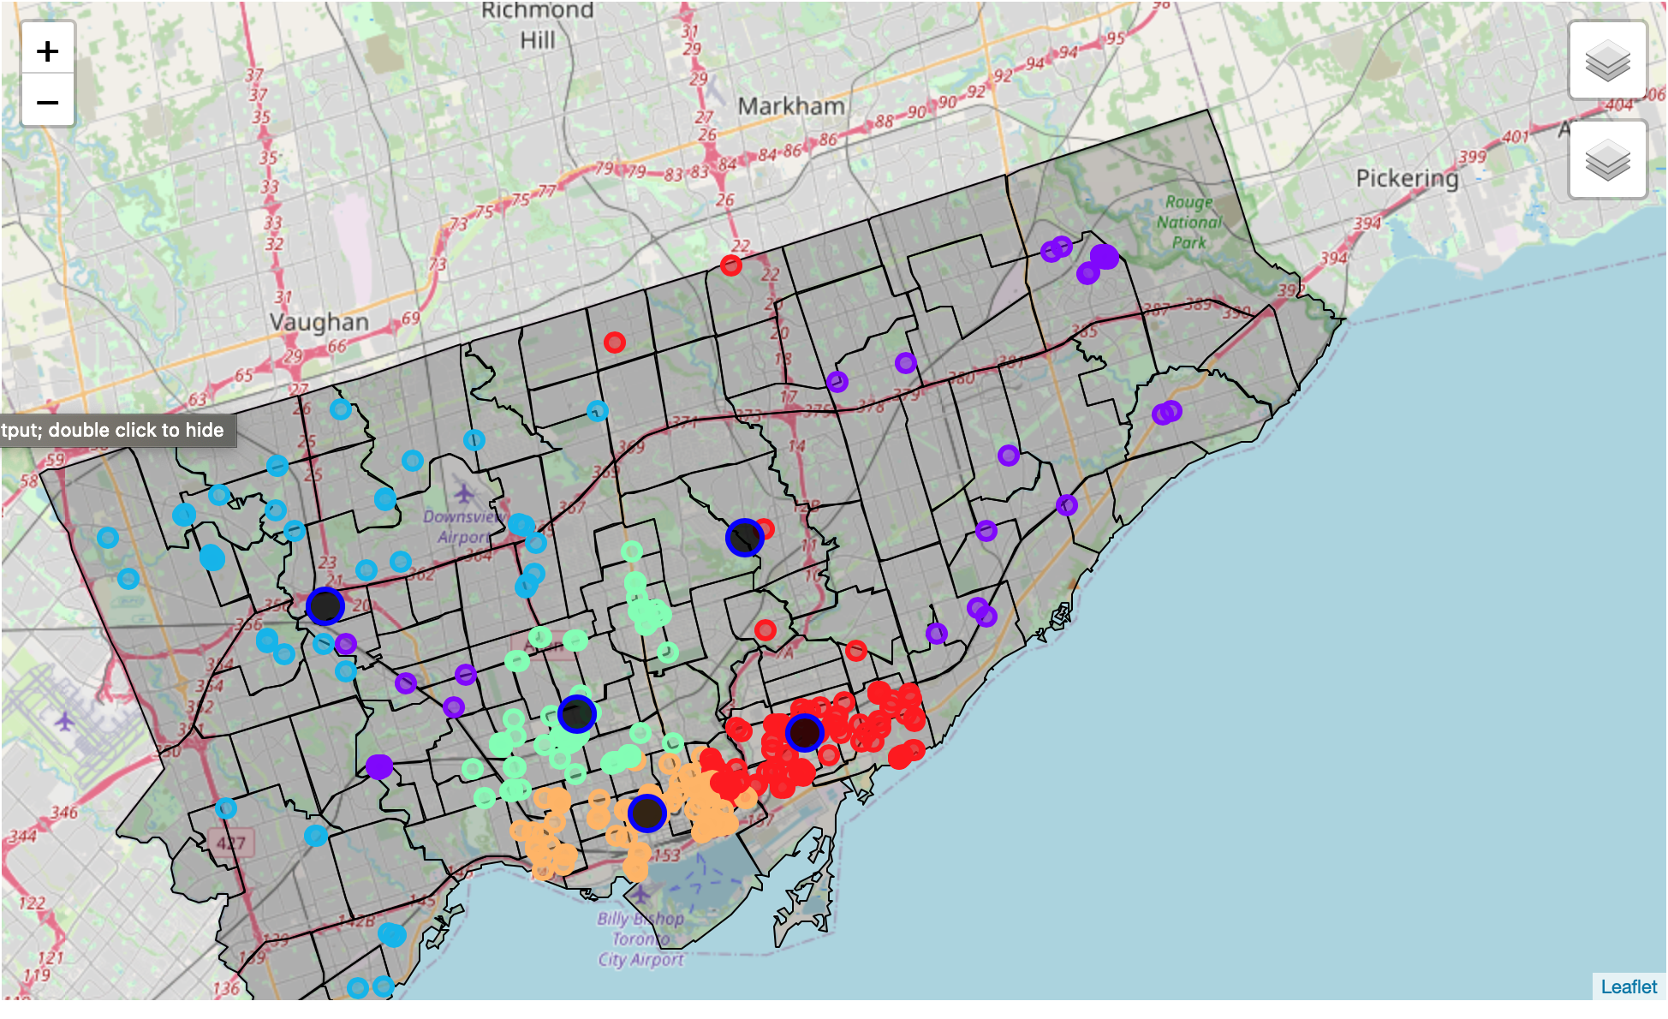
Cluster of markets
Data contain:
The number of markets in each area
The neighborhood codes
Geometry information
Using K-Mean clustering
Circles with different colors represent each cluster
Larger and dark circles represent the centers of each cluster

Slide 12
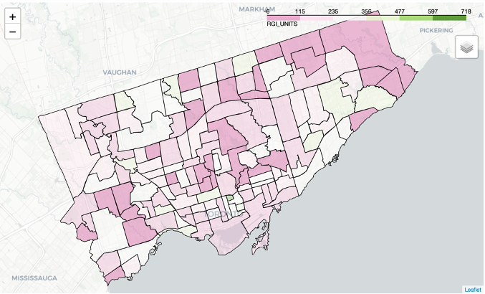
RGI Analysis
Data contains:
RGI in each area
Sort the data by RGI
Visualize the result into the map

Slide 13
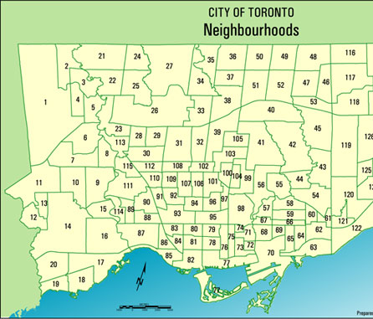
result
Any of these three neighborhoods is a good one to open a restaurant:
Waterfront Communities-The Island (Neighborhood Number: 77)
Niagara (Neighborhood Number: 82)
Mimico (Neighborhood Number: 17)
Possible type:
Canadian
Chinese
Fast food
Possible Strategies:
Advertise in centers of each clusters
Determine detailed location based on clusters of markets

Slide 14
Discussion
Data in 2016 is outdated
Analyzed the trends of the population between 2011 & 2016 to decrease the impact
Opening a restaurant can be complex project
This project is the first step to provide the overall situation in Toronto
Future study can include:
Salary Analysis
Competitiveness Analysis
The range of the price
The operation cost

Slide 15
Conclusion
This project provides a stable and viable plan to move a step forward for opening a restaurant in Toronto
Possible solution:
Neighborhood:
Waterfront Communities-The Island
Niagara
Mimico
Types:
Canadian
Chinese
Fast Food
Viable Strategies
Advertise in centers of each clusters
Determine specific location based on cluster of markets

Slide 16
Thanks for your watching

Slide 17
Citation
Toronto GDP: Statistics Canada. Table 36-10-0468-01 Gross domestic product (GDP) at basic prices, by census metropolitan area (CMA) (x 1,000,000)
Toronto Neighborhood Profile: Statistics Canada. 2016 Neighborhood Profiles

